Slide 1
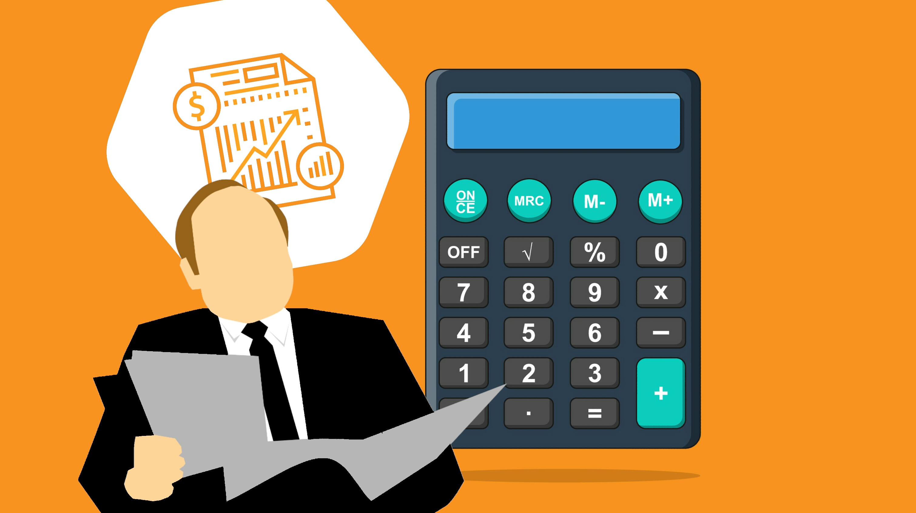
Personal Finance Analysis
Dashboard In Power BI

Slide 2
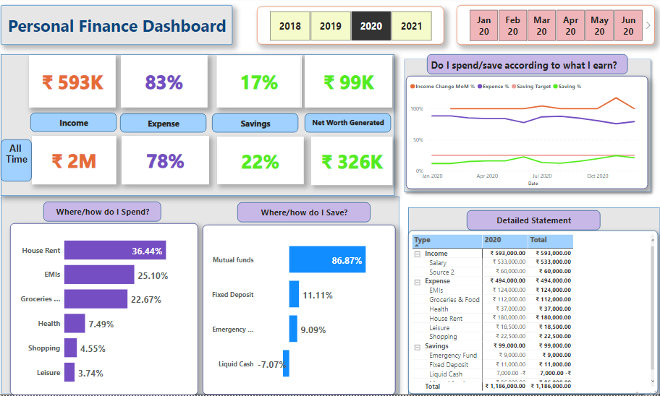
Finance Dashboard
Notes:
card
No alt text provided
card
No alt text provided
card
No alt text provided
card
No alt text provided
card
No alt text provided
card
No alt text provided
card
No alt text provided
card
No alt text provided
textbox
No alt text provided
slicer
No alt text provided
slicer
No alt text provided
card
No alt text provided
clusteredBarChart
No alt text provided
clusteredBarChart
No alt text provided
textbox
No alt text provided
shape
No alt text provided
shape
No alt text provided
shape
No alt text provided
textbox
No alt text provided
textbox
No alt text provided
textbox
No alt text provided
textbox
No alt text provided
textbox
No alt text provided
textbox
No alt text provided
textbox
No alt text provided
shape
No alt text provided
pivotTable
No alt text provided
lineChart
No alt text provided

Slide 3
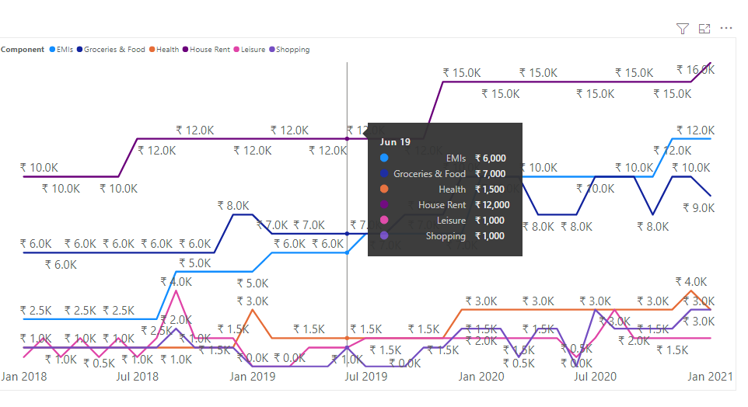
Expenses

Slide 4
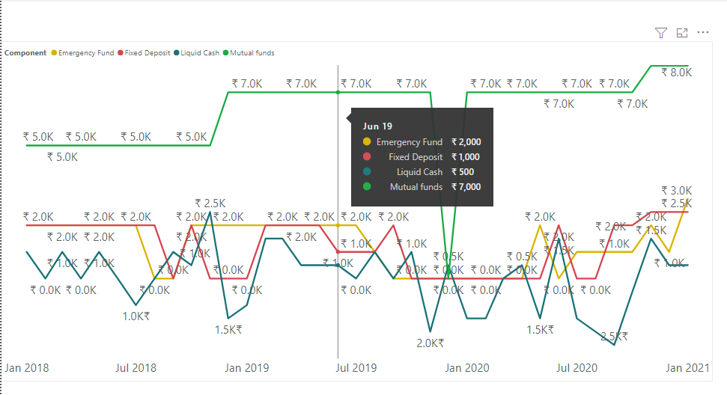
Savings

Slide 5
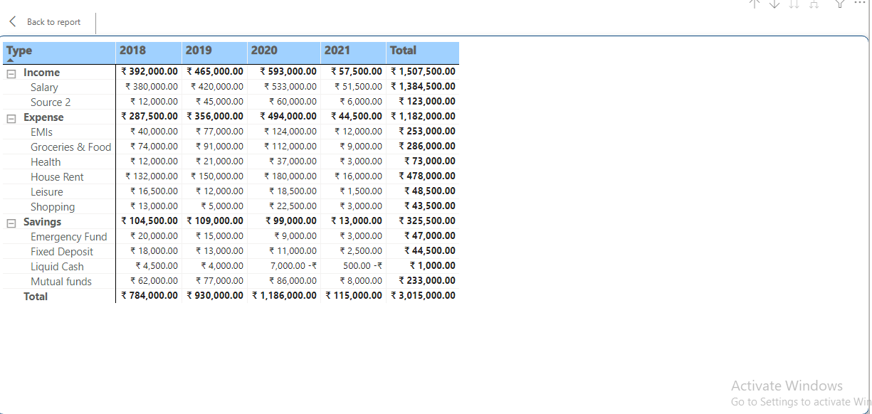
Detailed Statement

Slide 6
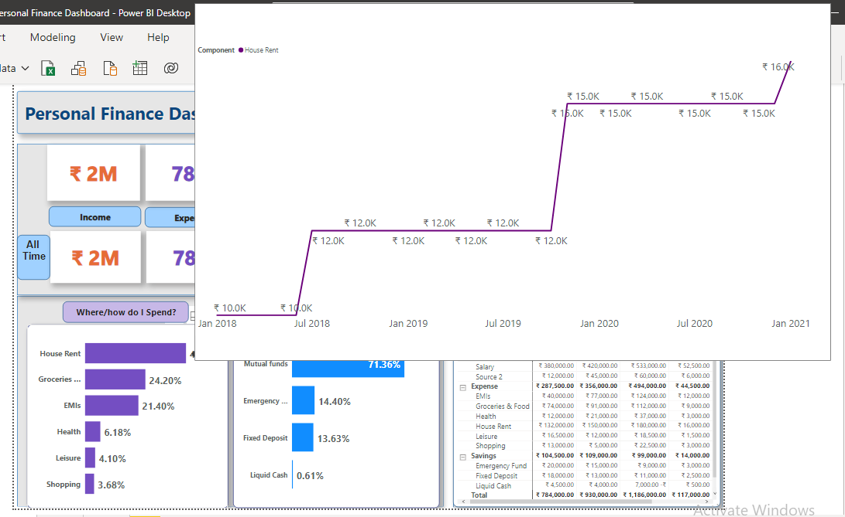

Slide 7
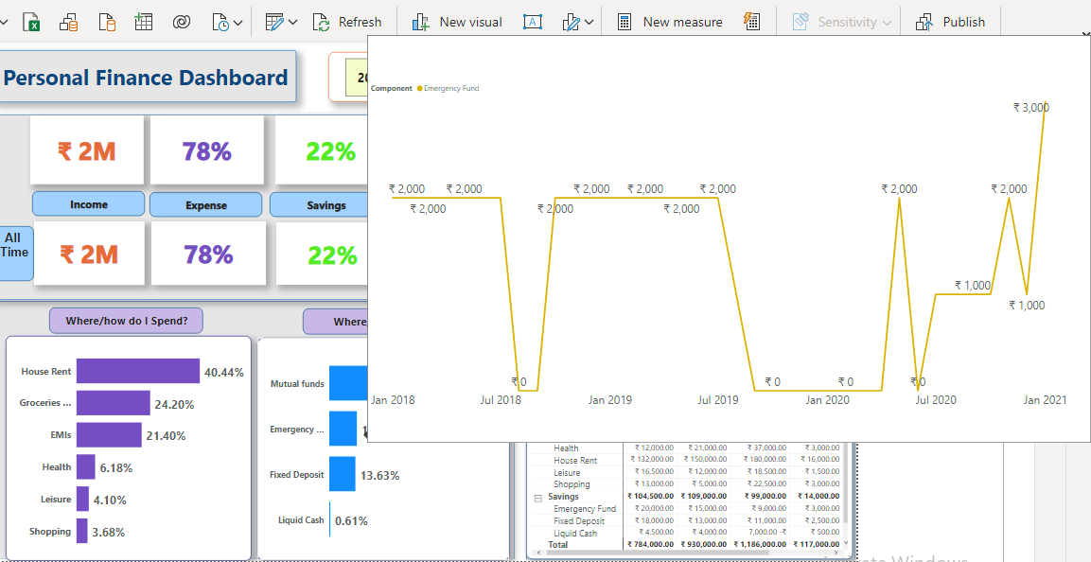

Slide 8
